Slide 1
Chapter 1-2 Fundamentals of Quantitative Design and Analysis

Slide 2
Computer Design Engineering life cycle
Evaluating Existing
Systems for Bottleneck(app.A)
Benchmarks(1.8)
User requirement
Analysis(1.2)
Technology Trend 1.4
Power Trend 1,5
Cost Trend 1.6
Dependability 1,7
Quantitative Principles
1.9
Implement Next
Generation System
Simulate New
Designs and
Organizations
Workloads
Evaluating for energy-performance cost (1.8)
Notes:
Requirement Analysis:
Market analysis: who you will sell 4-1.2
desktop, server, embedded system, HPC
Different markets has different driven motivations.
When design a desktop, it aims to obtain best price-performance.
For the servers, dependability is critical, then the scalability, and throughput.
For the embedded computer systems, price is a key factor, while real-time performance is important . And power efficiency and memory size is always under consideration.
2. Functional requirement: 4-1.3
3. Performance requirement:
4. Power
5. Unfuntional requirements: availability, dependibility 1.7
7. Cost/price

Slide 3
Topics in Chapter
1.1 Introduction
1.2 Classes of computers
1.3 Defining computer architecture and What’s the task of computer design?
1.4 Trends in Technology
1.5 Trends in power in Integrated circuits
1.6 Trends in Cost
1.7 Dependability
1.8 Measuring, Reporting and summerizing Perf.
1.9 Quantitative Principles of computer Design
1.10 Putting it altogether

Slide 4
5 computing markets
Feature | PMD | Desktop | Server | Clusters/ warehourse-scale computer | Internet of things /Embedded
Price of system | $100-$1000 | $300-$2500 | $5000 -$10,000,000 | $100000-$200,000,000 | $10 -$100,000
Price of microprocessor module | $10-$100 | $50-$500 per proc. | $200 -$2,000 per proc. | $50-$250 | $0.01 -$100 per proc.
Critical system design issues | Cost, energy, Media perf. responsiveness | Price-perf., Energy, Graphics perf. | Throughput, availability, Scalability, energy | Price-perf., Throughput, energy proportionality | Price, energy, application-specific performance.

Slide 5
Personal Mobile Devices
Wireless devices with multimedia user interfaces
ex. Smartphone, tablet computer,…
Application
Web-based， media-oriented
Responsiveness， predictability
Requirement:
Cost, energy efficiency ( battery, no-fan)
Real-time performance
Minimize memory → flash memory

Slide 6
Desktop Computing
The first, and still the largest market in dollar terms, is desktop computing. （laptop > 50% market of desktop )
Requirement:
Optimized price-performance
highest-perf. & cost-reduced Microprocessor appear first in desktop systems
New challenges:
Web-centric, interactive application
How to evaluate performance ?

Slide 7
Servers
The role of servers to provide larger scale and more reliable file and computing services grew.
Requirement:
First, availability is critical.
A second key feature of server systems is an emphasis on scalability. →memory,storage and I/O bandwidth is crucial.
Lastly, servers are designed for efficient throughput.

Slide 8
Cost with downtime
Application | Cost of downtime per hour | 1% 87.6 hrs/yr | 0.5% 43.8 hrs/yr | 0.1% 8.8 hrs/yr
Brokerage operations | $6,450,000 | $565,000,000 | $283,000,000 | $56,500,000
Credit card authorization | $2,600,000 | $228,000,000 | $114,000,000 | $22,800,000
Package shipping services | $150,000 | $13,000,000 | $6,600,000 | $1,300,000
Home shopping channel | $113,000 | $9,900,000 | $4,900,000 | $1,000,000
Catalog sales center | $90,000 | $7,900,000 | $3,900,000 | $800,000
Airline reservation center | $89,000 | $7,900,000 | $3,900,000 | $800,000
Cellular service activation | $41,000 | $3,600,000 | $1,800,000 | $400,000
Online network fees | $25,000 | $2,200,000 | $1,100,000 | $200,000
ATM service fees | $14,000 | $1,200,000 | $600,000 | $100,000

Slide 9
Cluster/Warehourse-Scale Computers
SaaS (Search,social networking, video sharing, multiplayer games, online-shopping)
WSC—tens of thousands of servers act as one
Requirements:
Price-performance, Power ( 10% saves $7M )
Availability is critical
Scalability ( Note the difference with server )
(Note the difference with supercomputer)

Slide 10
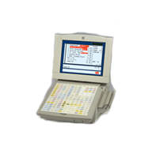
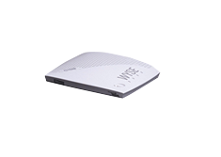
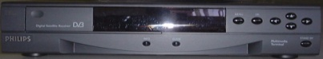
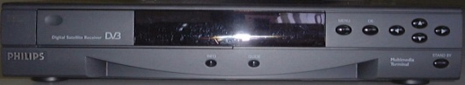
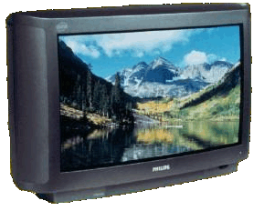
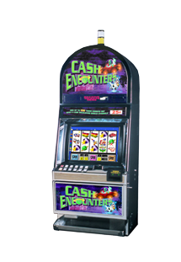
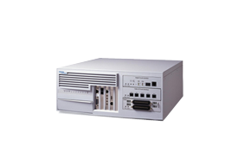
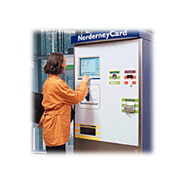
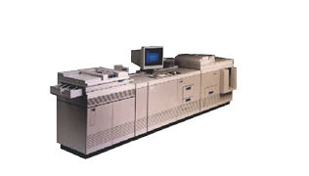
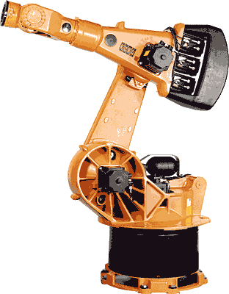
Embedded systems
Retail POS
Thin Clients
Set-Top-Box
Gateway/Media Store
Network Devices
Intel® Architecture
Intel® XScale™
Kiosk/ATM
Game Platforms
Office Automation
Industrial Automation

Slide 11
Embedded Computers
The fastest growing portion of the computer market with widest spread of processing power and cost.
Requirements
Real time performance (soft & hard)
Strict resource constraints
limited memory size, lower power consumption,...
The use of processor cores together with application-specific circuitry.
DSP, mobile computing, mobile phone, Digital TV

Slide 12
Other classification
Quantum computer vs Chemical computer,
Scalar processor vs Vector processor
Non-Uniform Memory Access (NUMA)/ UMA
Register machine vs Stack machine vs Accumulater machine
Harvard architecture vs Von Neumann architecture
/Non Von Neumann architecture （ 类脑芯片：达尔文2）
RISC vs. CISC
Cellular architecture
Notes:
Cellular architecture takes multi-core architecture design to its logical conclusion, by giving the programmer the ability to run large numbers of concurrent threads within a single processor. Each 'cell' is a compute node containing thread units, memory, and communication. Speed-up is achieved by exploiting thread-level parallelism inherent in many applications.

Slide 13
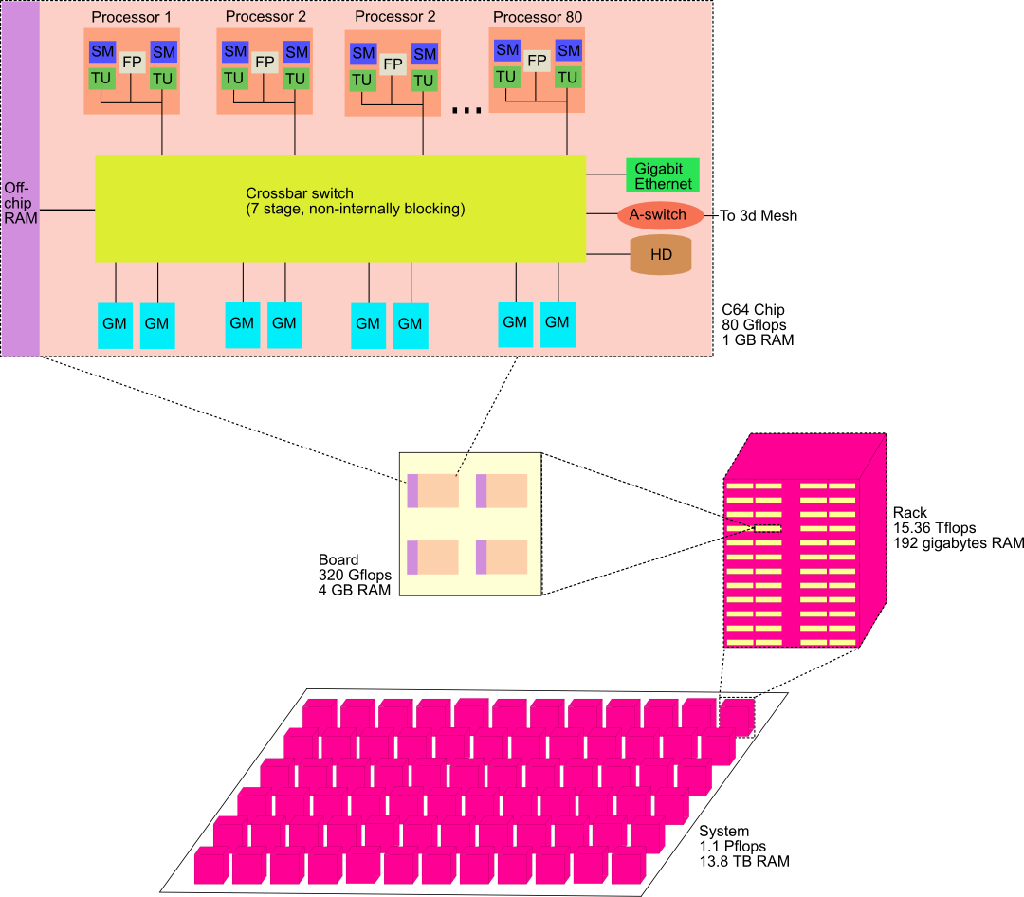
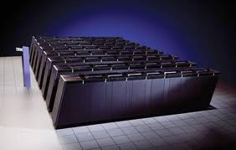
Cellular architecture
Cyclops64 (known as Blue Gene/C)
IBM's Cell microprocessor is the first one to reach the market.
Cellular architecture takes multi-core architecture design to its logical conclusion, by giving the programmer the ability to run large numbers of concurrent threads within a single processor. Each 'cell' is a compute node containing thread units, memory, and communication. Speed-up is achieved by exploiting thread-level parallelism inherent in many applications.

Slide 14
Classes of Parallelism and Parallel Architecture
Two kinds of parallelism in application
Data-level Parallelism（DLP）
Task-level Parallelism （TLP）
Hardware exploit in 4 major ways
Instruction level Parallelism
Vector Architecture and GPUs
Thread-Level Parallelism
Request-Level parallelism

Slide 15
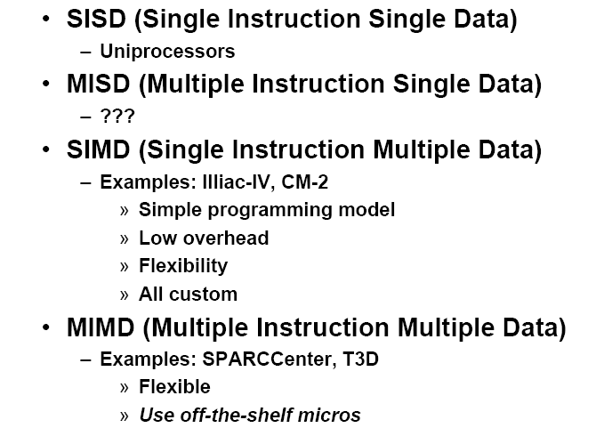

Classes of computers
Flynn’s Taxonomy: A classification of computer architectures based on the number of streams of instructions and data
Notes:
Proposed at 1966.
^ Flynn, M., Some Computer Organizations and Their Effectiveness, IEEE Trans. Comput., Vol. C-21, pp. 948, 1972.
^ Duncan, Ralph, "A Survey of Parallel Computer Architectures", IEEE Computer. February 1990, pp. 5-16.

Slide 16
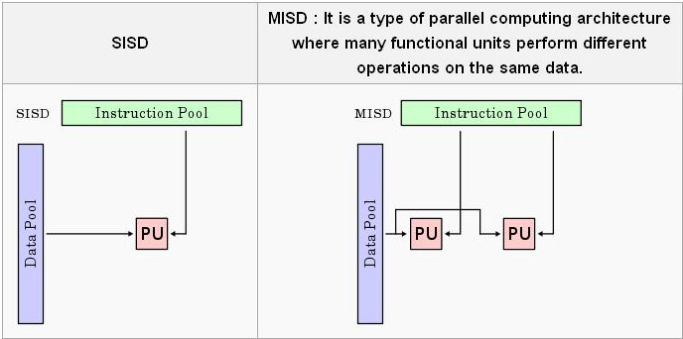
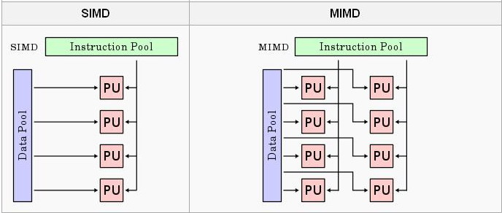
classification

Slide 17
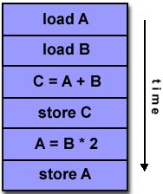
SISD
A serial (non-parallel) computer
Single instruction: only one instruction stream is being acted on by the CPU during any one clock cycle
Single data: only one data stream is being used as input during any one clock cycle
Deterministic execution
This is the oldest and until recently, the most prevalent form of computer
Examples: most PCs, single CPU workstations and mainframes

Slide 18
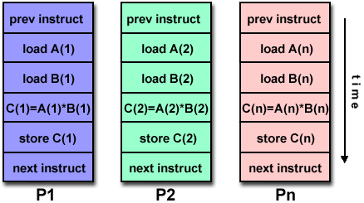
SIMD
A type of parallel computer
Single instruction: All processing units execute the same instruction at any given clock cycle
Multiple data: Each processing unit can operate on a different data element
This type of machine typically has an instruction dispatcher, a very high-bandwidth internal network, and a very large array of very small-capacity instruction units.
Best suited for specialized problems characterized by a high degree of regularity,such as image processing.
Synchronous (lockstep) and deterministic execution
Two varieties:
Processor Arrays: Connection Machine CM-2, Maspar MP-1, MP-2
Vector Pipelines: IBM 9000, Cray C90, Fujitsu VP, NEC SX-2, Hitachi S820

Slide 19
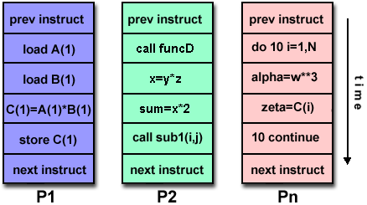
MIMD
Currently, the most common type of parallel computer. Most modern computers fall into this category.
Multiple Instruction: every processor may be executing a different instruction stream
Multiple Data: every processor may be working with a different data stream
Execution can be synchronous or asynchronous, deterministic or non-deterministic
Examples: most current supercomputers, networked parallel computer "grids" and multi-processor SMP computers - including some types of PCs.

Slide 20
Topics in Chapter
1.1 Why take this course ?
1.2 Classes of computers in current computer market
1.3 Defining computer architecture and What’s the task of computer design?
1.4 Trends in Technology
1.5 Trends in power in Integrated circuits
1.6 Trends in Cost
1.7 Dependability
1.8 Measuring, Reporting and summerizing Perf.
1.9 Quantitative Principles of computer Design
1.10 Putting it altogether

Slide 21
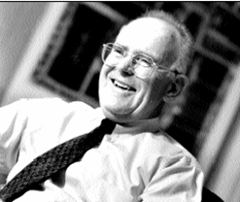
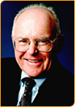
Technology Trends
Moore Law
In 1965 he predicted that the number of components the industry would be able to place on a computer chip would double every year. In 1975, he updated his prediction to once every two years. It has become the guiding principle for the semiconductor industry to deliver ever-more-powerful chips while decreasing the cost of electronics.
Transistor density 2x in 18-24 months (1.4-1.5x/year )
DRAM density
1977-1997： 1.46x/year
1997-2017： 1.34x/year
2017-2022： 1.1x/year
Gordon Moore

Slide 22
Gordon Moore on Moore’s law
Moore’s brief Bio
http://www.intel.com/pressroom/kits/bios/moore.htm
Gordon Moore on Moore’s law
http://www.sichinamag.com/Article/html/2007-09/2007919032802.htm
Video on conversation with Moore
http://you.video.sina.com.cn/b/7076856-1282136212.html

Slide 23
Technology Trends
Designers often design for the next technology.
Integrated circuit logic technoloty
Transistor Density: incr. 35% per year, (4x every 4 years)
Die size: 10%-20% per year
Transistor count per chip:40-55% per year or 2x 10 to 24 months
Semiconductor DRAM
Capacity per DRAM: 25%-40% per year (2x every 2-3 years)
Memory speed: about 10% per year
Might stop and may be replaced
Semiconductor Flash – standard storage device in PMDs
Capacity per flash chip：50-60% per year （ 2x every 2 years）
15-20 times cheaper than DRAM
Magnetic Disk tech.
Desnsity: 30% p.y. Before 1990; 60% p.y. 1990-1996
100 p.y. 1996-2004 ; 30% p.y. after 2004
capacity: about 60% per year
Network
bandwidth: 10Mb ⎯⎯⎯→ 100Mb ⎯⎯⎯→ 1Gb
10 years 5 years

Slide 24
Improvement of DRAM rate
AQA Edition | Year | DRAM growth | Characterization of impact on DRAM capacity
1 | 1990 | 60% / year | Quadrupling every 3 years
2 | 1996 | 60% / year | Quadrupling every 3 years
3 | 2003 | 40%-60%/ year | Quadrupling every 3 to 4 years
4 | 2007 | 40% / year | Doubling every 2 years
5 | 2011 | 25% - 40% / year | Doubling every 2 - 3 years

Slide 25
Import Notes
A rule of thumb
Cost decrease rate ~ density increase rate
Technology thresholds
Technology improves continuously, an impact of this improvements can be in discrete leaps.

Slide 26
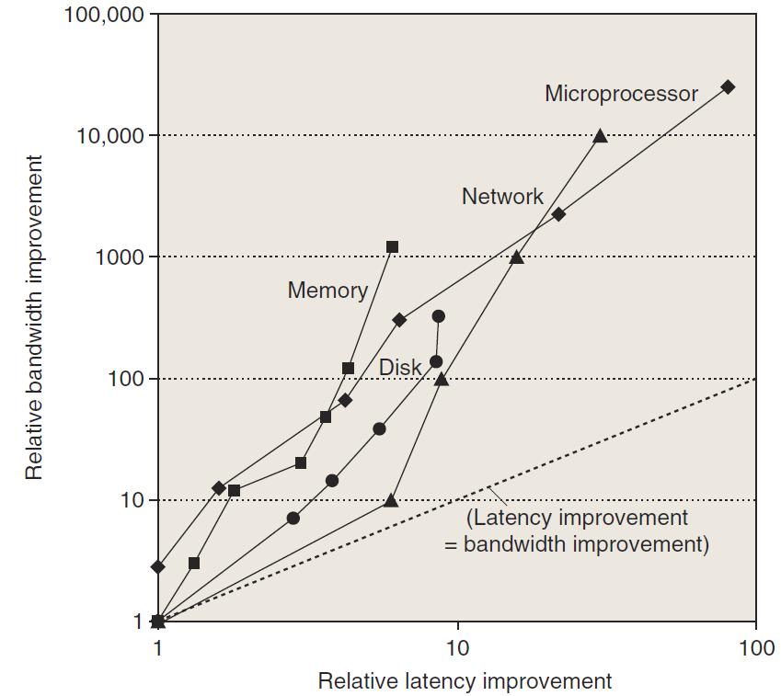
Perf. Trends: Bandwidth over latency
Bandwidth/throughput: total amount of work done in a given time
Latency/response time: the time between the start and the completion of an event.
Rule of thumb
Bandwidth grow rate ~ improvement in latency²
10，000X—25，000X in Bandwidth
30X—80X in latency

Slide 27
Performance milestones in microprocessor

Slide 28
Challenges for IC Tecnology
IC characteristic: feature size(特征尺寸）
10 microns in 1971 → 0.18microns in 2001
→ 0.09 microns in 2006 → 0.032 microns in 2011
7nm is under way.
Rule of thumb: transistor perf. Improves linearly with decreasing feature size.
IC density improvement is both opportunity and Challenge:
signal delay for a wire increase in proportion to the product of its resistance and capacitance.
Wire delay---major design limitation

Slide 29
Bad prediction with big guy
“There is no reason anyone would want a computer in their home.”
--Ken Olson, president,
Chairman and founder of Digital Equipment Corp., 1977

Slide 30
Topics in Chapter
1.1 Why take this course ?
1.2 Classes of computers in current computer market
1.3 Defining computer architecture and What’s the task of computer design?
1.4 Trends in Technology
1.5 Trends in power and Energy in Integrated circuits
1.6 Trends in Cost
1.7 Dependability
1.8 Measuring, Reporting and summerizing Perf.
1.9 Quantitative Principles of computer Design
1.10 Putting it altogether

Slide 31
Trends in Power
Power also provide challenges as device scaled
first microprocessor: 1/10watt -->
2GHz P4: 135watt
Challenges:
distributing the power
removing the heat
preventing hot spot

Slide 32
Techiques to save engery
Do nothing well----stop the clocks when cores are idle.
Dynamic Voltage – Frequency Scaling (DVFS)
A few clock frequency and voltages
Design for typical case
Lower power modes（LPM） –save power
Can not access DRAM or disk when in LPM
Overlocking
Turn off all cores but one and run at higher clok rate.
Race-to-halt
Use a faster， less energy-efficient processor to allow the rest of the system to to into a sleep mode

Slide 33
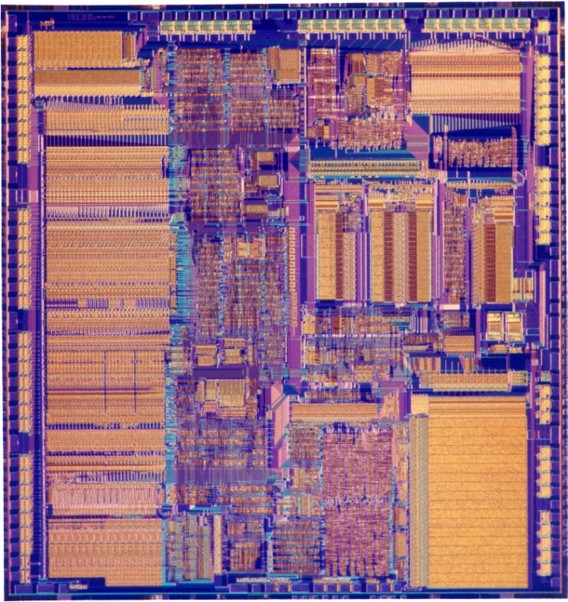
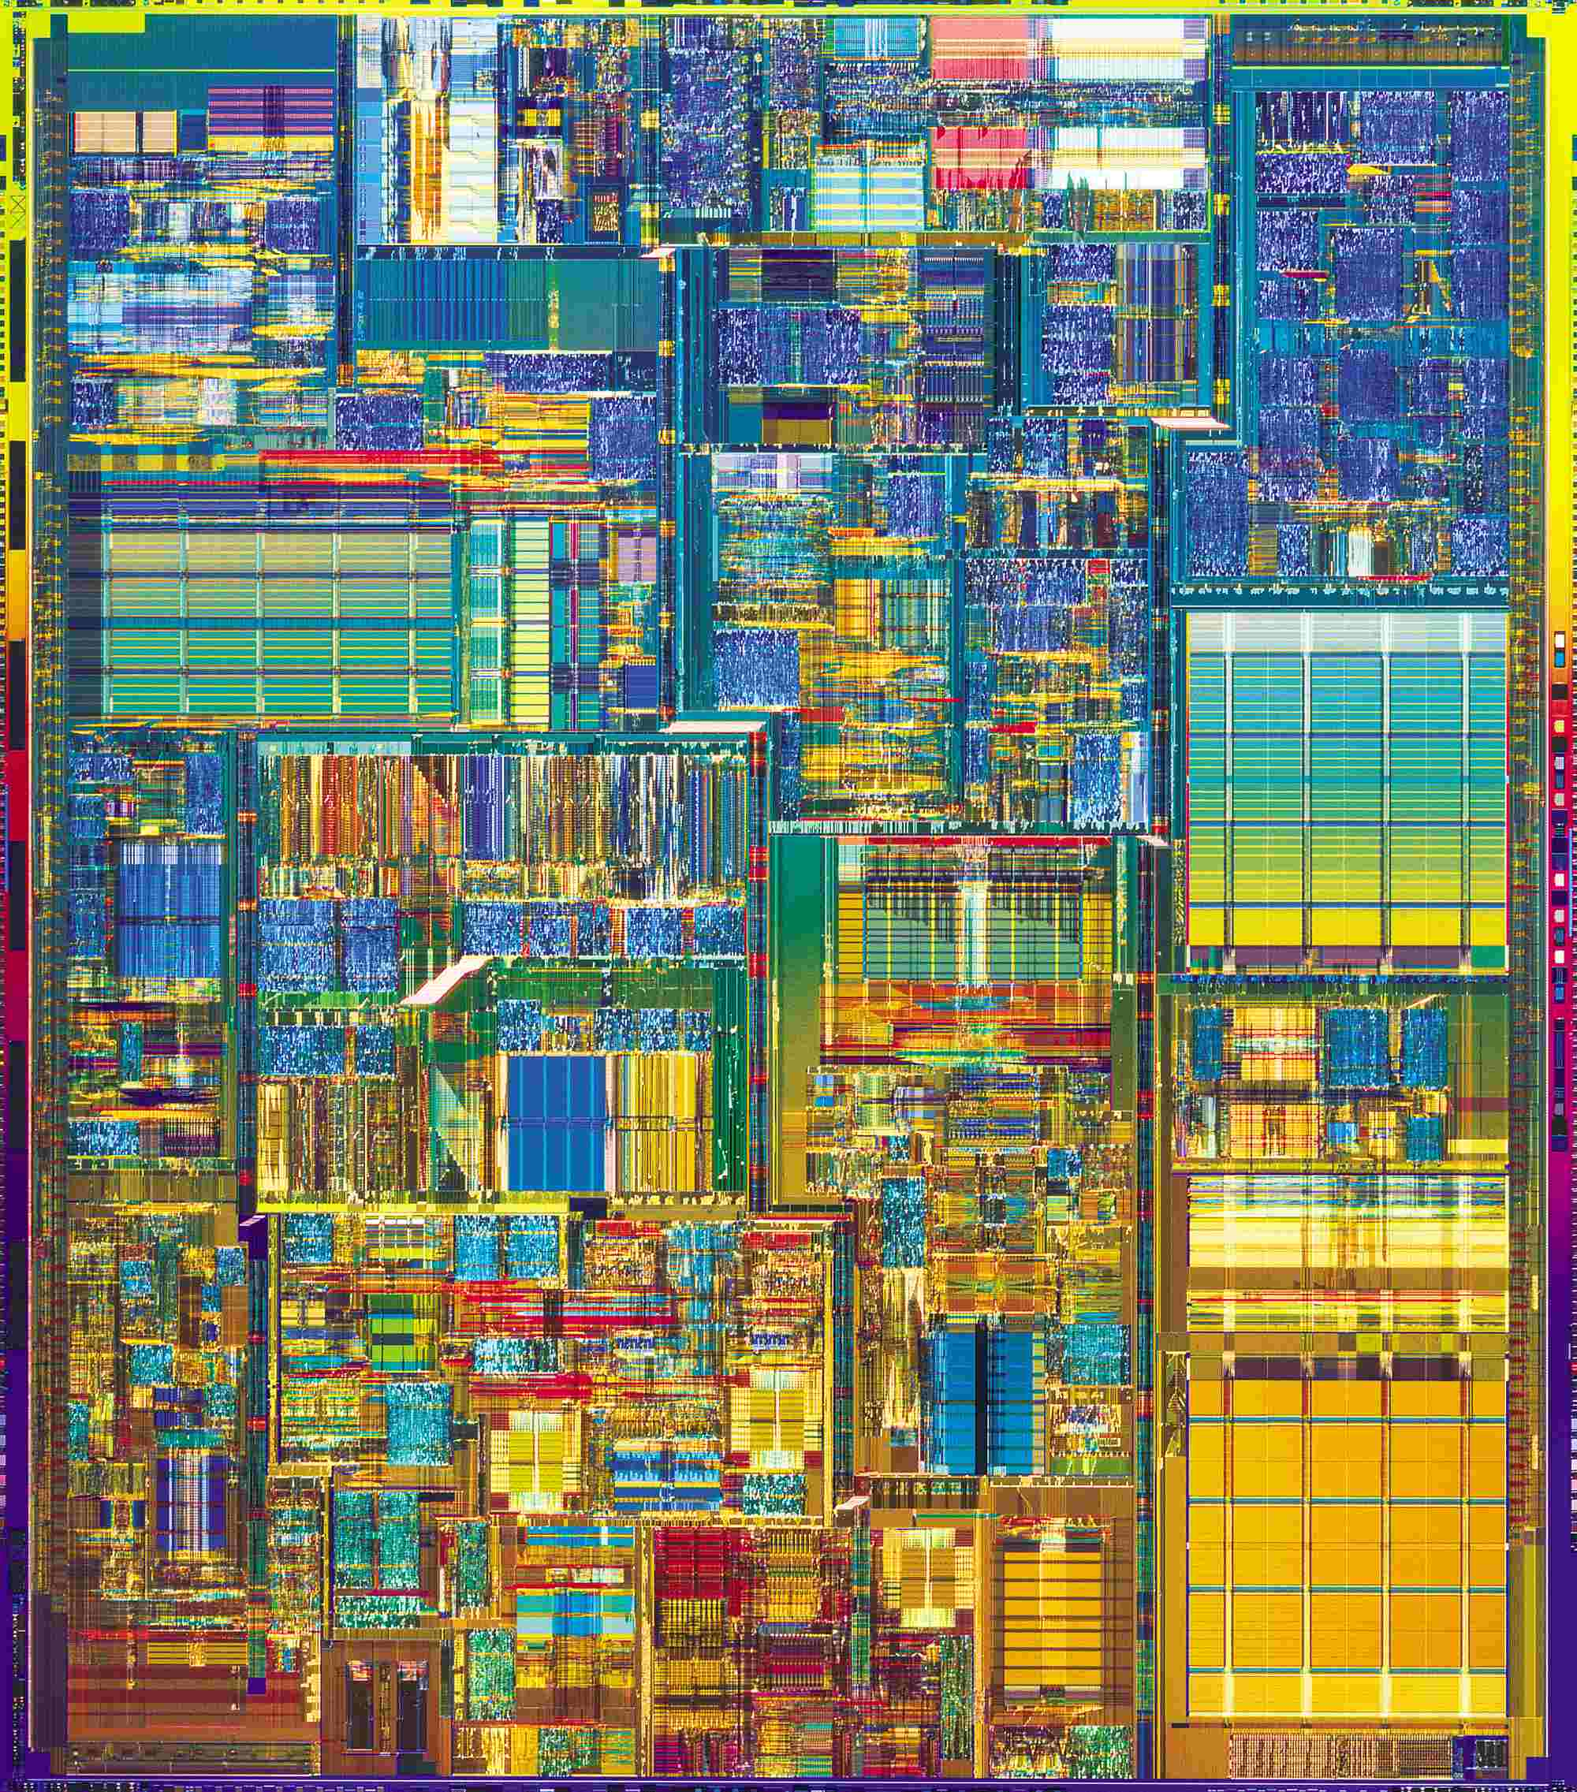
Compare the performance / power
Pentium® 4 Processor
386 Processor
May 1986
@16 MHz core
275,000 1.5µ transistors
~1.2 SPECint2000
17 Years
200x
200x/11x
1000x
August 27, 2003
@3.2 GHz core
55 Million 0.13µ transistors
1249 SPECint2000

Slide 34
Power efficiency
Power efficiency has dropped
Performance scales with area**.5

Slide 35
Two concepts
Dynamic power: power consumption in switching transistors.
Power _{dynamic} = ½ *Capacitive load * Voltage² * Frequency switched
Energy _{dynamic} = Capacitive load * Voltage²
Static power: power consumption when a transistor is off due to power leakage
Power _{static} = current static * Voltage

Slide 36
Rule of Thumb
10% reduction of voltage yields
10% reduction in frequency
30% reduction in power
Less than 10% reduction in performance
Rule of Thumb
Voltage | Frequency | Power | Performance
1% | 1% | 3% | 0.66%

Slide 37
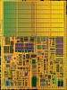
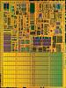
Dual core with voltage scaling
RULE OF THUMB
A 15%
Reduction
In Voltage
Yields
Frequency Reduction | Power Reduction | Performance Reduction
15% | 45% | 10%
SINGLE CORE
DUAL CORE
Area = 1
Voltage = 1
Freq = 1
Power = 1
Perf = 1
Area = 2
Voltage = 0.85
Freq = 0.85
Power = 1
Perf = ~1.8

Slide 38
Multiple cores deliver more performance per watt
Cache
Power
Big core
4
3
Performance
2
2
Small
core
1
1
1
1
Many core is more power efficient
Power ~ area
Single thread performance ~ area**.5
C1
C2
4
4
Cache
3
3
C3
C4
2
2
1
1

Slide 39
Why Multicore?

Slide 40
Topics in Chapter
1.1 Why take this course ?
1.2 Classes of computers in current computer market
1.3 Defining computer architecture and What’s the task of computer design?
1.4 Trends in Technology
1.5 Trends in power in Integrated circuits
1.6 Trends in Cost
1.7 Dependability
1.8 Measuring, Reporting and summerizing Perf.
1.9 Quantitative Principles of computer Design
1.10 Putting it altogether

Slide 41
Major Theme: Lower Cost
Cost Trend
Understanding cost trends of component is important for designers, since we design for tomorrow !
The impact factors for cost:
Time----Component prices drop over time without major improvements in manufacturing technology
Volume ----Volume decreases cost due to increases in manufacturing efficiency.
Commodification----The competition among the suppliers of the components will decrease overall product cost.

Slide 42
Understanding Cost Trend by Learning Curve

Slide 43
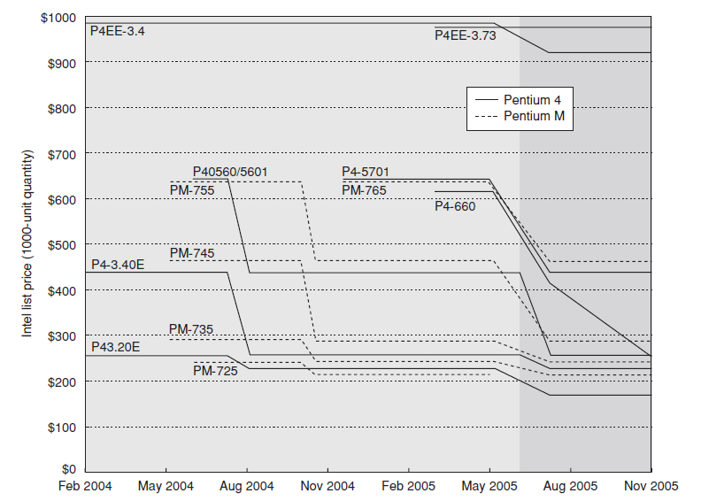
Price of Pentium4 & PentiumM

Slide 44
Rules of Thumb
Time: learning curve ----yield
Twice the yield will have half the cost.(for chip, board, or a system)
Volume:
Cost decrease about 10% for each doubling of volume.
Commodities:
Vendor competition
Supplier competition
Volume increase, however limited profits.
Notes:
Volume affect the cost
缩短了learning curve下拐的时间, 下降的时间与制造的系统数量部分成正比.
提高了购买和制造效率,降低成本
数量会减少开发成本,因为成本是分摊到各台计算机的.

Slide 45
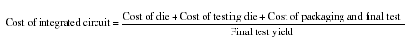
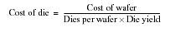
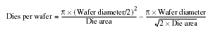
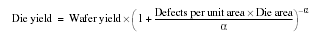
Cost of an Integrated Circuit

Slide 46
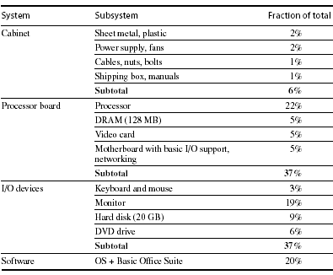
Distribution of Cost in a System

Slide 47
Cost vs. Price
Component costs
Raw material cost.
Direct cost:
Costs incurred to make a single item. Adds 20% to 40% to component cost.
Gross margin ( Indirect cost):
Overhead not associated with a single item, i.e. R&D, marketing, manufacturing equipment, taxes, etc.
Only 4%-12% of income are spent on R&D
Average Selling Price (ASP):
Component cost + direct cost + indirect cost.
List price :
Not ASP. Stores add to the ASP to get their cut. Want 50% to 75% of list price.

Slide 48
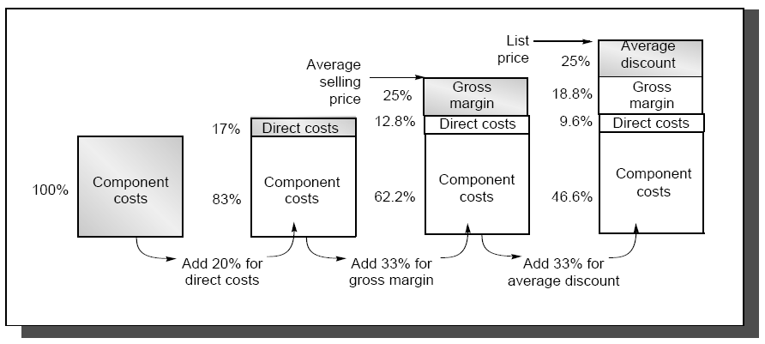
The components of price for a $1000 PC

Slide 49
Cost vs. Price
This gives you insight on how a design decision will affect selling price,
i.e. changing cost by $1,000 increases selling price by $3,000 to $4,000.
Also, consider volume and price relationship:
In general, the fewer computers that are sold, the higher the price.
Also, a decrease in volume causes cost to increase, further increasing price.
Therefore, small changes in cost can have an unexpected large increase in price.

Slide 50
Computer Design Engineering life cycle
Evaluating Existing
Systems for Bottleneck(app.A)
Benchmarks(1.8)
User requirement
Analysis(1.2)
Technology Trend 1.4
Power Trend 1,5
Cost Trend 1.6
Dependability 1,7
Quantitative Principles
1.9
Implement Next
Generation System
Simulate New
Designs and
Organizations
Workloads
Evaluating for energy-performance cost (1.8)
Notes:
Requirement Analysis:
Market analysis: who you will sell 4-1.2
desktop, server, embedded system, HPC
Different markets has different driven motivations.
When design a desktop, it aims to obtain best price-performance.
For the servers, dependability is critical, then the scalability, and throughput.
For the embedded computer systems, price is a key factor, while real-time performance is important . And power efficiency and memory size is always under consideration.
2. Functional requirement: 4-1.3
3. Performance requirement:
4. Power
5. Unfuntional requirements: availability, dependibility 1.7
7. Cost/price

Slide 51
Topics in Chapter
1.1 Why take this course ?
1.2 Classes of computers in current computer market
1.3 Defining computer architecture and What’s the task of computer design?
1.4 Trends in Technology
1.5 Trends in power in Integrated circuits
1.6 Trends in Cost
1.7 Dependability
1.8 Measuring, Reporting and summerizing Perf.
1.9 Quantitative Principles of computer Design
1.10 Putting it altogether

Slide 52
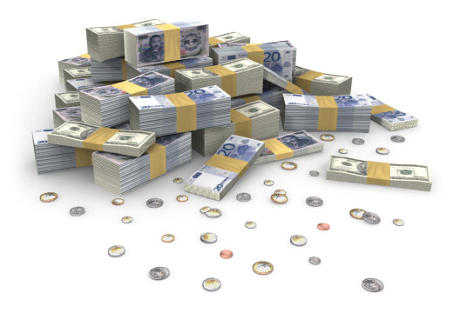
Why Business Continuity ?
Lost Productivity
Know the downtime costs (per hour, day, two days...)
Lost Revenue
Number of employees impacted (x hours out * hourly rate)
Direct loss
Compensatory payments
Lost future revenue
Billing losses
Investment losses
Damaged Reputation
Financial Performance
Customers
Suppliers
Financial markets
Banks
Business partners
Revenue recognition
Cash flow
Lost discounts (A/P)
Payment guarantees
Credit rating
Stock price
Other Expenses
Temporary employees, equipment rental, overtime costs, extra shipping costs, travel expenses...

Slide 53
Why high Dependability ?
Millions of US Dollars per Hour in Lost Revenue
Retail
1.1
Insurance
1.2
Information technology
1.3
Financial institutions
1.5
Manufacturing
1.6
Call location
1.6
Telecommunications
2.0
Credit card sales authorization
2.6
Energy
2.8
Point of sale
3.6
Retail brokerage
6.5
Source Meta Group, 2005

Slide 54
Information Availability(5个9)
% Uptime | % Downtime | Downtime per Year | Downtime per Week
98% | 2% | 7.3 days | 3hrs 22 min
99% | 1% | 3.65 days | 1 hr 41 min
99.8% | 0.2% | 17 hrs 31 min | 20 min 10 sec
99.9% | 0.1% | 8 hrs 45 min | 10 min 5 sec
99.99% | 0.01% | 52.5 min | 1 min
99.999% | 0.001% | 5.25 min | 6 sec
99.9999% | 0.0001% | 31.5 sec | 0.6 sec

Slide 55
Evolvement of Dependability-1
Reliability (可靠性) 1960s
----field of fault tolerance and system reliability
Definition
In general, reliability (systemic def.) is the ability of a person or system to perform and maintain its functions in routine circumstances, as well as hostile or unexpected circumstances.
The IEEE defines it as ". . . the ability of a system or component to perform its required functions under stated conditions for a specified period of time."
The Institute of Electrical and Electronics Engineers

Slide 56
Evolvement of Dependability-2
Dependability (可信性)
1985, Jean-Claude Laprie
J.C. Laprie. "Dependable Computing and Fault Tolerance: Concepts and terminology," in Proc. 15th IEEE Int. Symp. on Fault-Tolerant Computing, 1985
International Conference on dependable Systems and networks
International Symposium on Reliable Distributed Systems
International Symposium on Software Reliability Engineering.

Slide 57
Definition 1 of Denpendability
Computer system dependability is The quality of the delivered service such that reliance can justifiably be placed on this service.
J.C. Laprie. "Dependable Computing and Fault Tolerance: Concepts and terminology," in Proc. 15th IEEE Int. Symp. on Fault-Tolerant Computing, 1985
reliability, maintainability, availability, safety, are quantitative measures corresponding to distinct perceptions of the same attribute of a system: it’s dependability
general concept
Notes:
Error, fault, failure

Slide 58
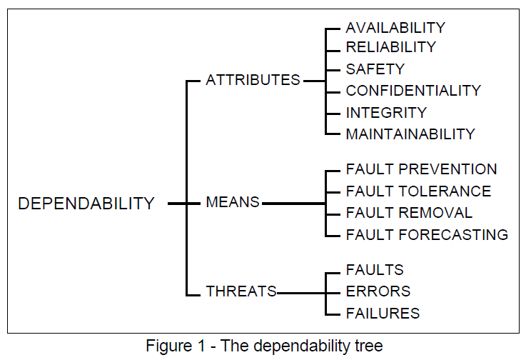
Definition 2 of Denpendability
A. Avizienis, J.-C. Laprie and B. Randell: Fundamental Concepts of Dependability. Research Report No 1145, , April 2001
Denpendability&
Security
Notes:
Error, fault, failure

Slide 59
Related concepts
Availability(可用性) - readiness for correct service
Reliability(可靠性) - continuity of correct service
Safety(平安性?) - absence of catastrophic consequences on the user(s) and the environment
Integrity(完整性) - absence of improper system alteration
Maintainability(可维护性) - ability to undergo modifications and repairs
Confidentiality(机密性), the absence of unauthorized disclosure of information
Security(安全保障) is a composite of Confidentiality, Integrity, and Availability.

Slide 60
Dependability(可信性)
Service level Agreements(SLA) / Service level objectives (SLO)
Service accomplishment
Service interruption
Failures:
S_{accomplishment} →S_{interruption}
Restorations:
S_{interruption} →S_{accomplishment}

Slide 61
Measurements of Dependability
Module reliability: continuous service accomplishment ( of the time to failure )
MTTF: Mean Time To Failure
MTTR: Mean Time To Repair (service interruption)
FIT: Failure In Time = 1/MTTF
MTBF: Mean Time Between Failure = MTTF+MTTR
Module availability
MTTF = MTTF
MTTF + MTTR MTBF

Slide 62
Example: disk system
Assumption:
10 disks, 1000000 hour MTTF
1 SCSI controller, 500000 hour MTTF
1 power supply, 1 fan, both 200000 hour MTTF
1 SCSI cable, 1000000 hour MTTF
Question: MTTR of the whole system
Answer:
Failure rate_{system} = 10*1/1000,000 + 1/500,000 + 1/200,000 + 1/100,000
= 23000/1000,000,000
MTTF_{system} = 1/Failure_{system} = 43500 hours ~ 5 years

Slide 63
Way to cope with failure
Redundancy:
Time redundancy: repeat the operation again to see if it is still in erroneous.
Resource redundancy: have other components to take over from the one that failed.

Slide 64
Dependability
Compare with
Trusted computing
Trustworthy computing
Credibility

Slide 65
Topics in Chapter
1.1 Why take this course ?
1.2 Classes of computers in current computer market
1.3 Defining computer architecture and What’s the task of computer design?
1.4 Trends in Technology
1.5 Trends in power in Integrated circuits
1.6 Trends in Cost
1.7 Dependability
1.8 Measuring, Reporting and summerizing Perf.
1.9 Quantitative Principles of computer Design
1.10 Putting it altogether

Slide 66
Measuring and Reporting Performance
Comparing Machines
Execution time (latency)
Throughput
MIPS - millions of instructions per second
Comparing Machines Using Sets of Programs
Choosing which program to evaluate performance
Benchmark Suites
Different Means: Arithmetic, Harmonic, and Geometric Means

Slide 67



Ddifferent perception
Performance means different things to different people, therefore its assessment is subtle
different perception
Criteria of performance evaluation differs among users and designers
Just a piece of
cake ! Even for 50 guys
Faint ! When will
they bring me the meal?
Sorry, Lady is first !

Slide 68

Perf. Metrics --response time
Wall-clock time
Start the program and watch the clock -
when the program ends, that’s the total wall-clock time
Also called response time or elapsed time or
Measures user perception of the system speed
Problems with wall-clock time
What if more than one program is running on
the same machine ?
What if the program asks for user input ?

Slide 69
Performance Metrics --CPU time
Measures the time the CPU is computing, (not waiting for I/O)
Measures designer perception of the CPU speed
CPU time is further divided into:
User time - time spent in user mode
System time - time spent in the operating system (OS)
Unix time command reports CPU time as:
90.7u 12.9s 2:39 65%
90.7 user CPU seconds (in the user’s program)
12.9 system CPU seconds (in the system calls e.g. printf)
2 minutes, 39 seconds wall-clock time
65% of the wall clock time was spent running on the CPU

Slide 70
Performance Metrics --throughput
Amount of work done in a given time
Measure administrator perception of the system perf.
We often use throughput to measure
Number of lines of code per day
Number bits per second transmitted over a wire
Number of web pages served
In contrast to latency
amount of time to produce 1 line of code
amount of time to send 1 bit over a wire
Amount of time spent waiting to receive web page
Often, processor performance is only quoted in terms of relative latency
Program A ran 10 times faster than program B
But, for many apps, throughput much more important than latency
Financial markets, government statistics (census)

Slide 71
Response time vs. Throughput
If you improve response time, you usually improve throughput
Replacing the processor of a computer with a faster version
you can also improve throughput without improving response time
Adding additional processors to a system that uses multiple processors
for separate tasks (e.g. handling of airline reservations system)

Slide 72
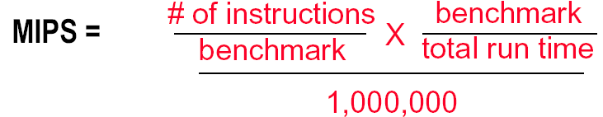
Another industry Metric: MIPS
MIPS - Millions of Instructions per Second
When comparing two machines (A, B) with the same instruction set, MIPS is a fair comparison(sometimes…)
But, MIPS can be a “meaningless indicator of performance…”

Slide 73
Ex: MIPS might be meaningless
Machine A has a special instruction for performing square root calculations. It takes 100 cycles to execute.
Machine B doesn’t have the special instruction -- must perform square root calculations in software using simple instructions (.e.g, Add, Mult, Shift) that each take 1 cycle to execute
Machine A: 1/100 MIPS = 0.01 MIPS
Machine B: 1 MIPS

Slide 74
Another view: Power consumption and Efficiency
Critical factors for embedded systems:
cost
physical size
memory
power consumption
Fig. 1.27
AMD ElanSC520
AMD K6-2E
IBM PowerPC 750CX
NEC VR 5432
NEC VR 4122
The NEC VR 4122 is the big
winner for its best performance/watt,
though it is the second lowest performing processor.

Slide 75
Summary of performance metrics
Response (Execution) time
user perception
system performance
the only unimpeachable measure of performance
CPU time
designer perception
CPU performance
Throughput
administrator perception
MIPS
merchant perception

Slide 76
Choose Programs to Evaluate Performance
Ideal performance evaluation:
A random sample of users running their programs and OS commands.
Many different types of benchmarks
Real applications--- Scientific and engineering
Modified (or scripted) applications--- focus on specific features
Kernels --- critical program fragments
Toy --- small programs, often measure very little
Synthetic -- created to represent some aspects of a program (e.g., mix of instruction types)
Database -- a world unto itself
What really matters is how YOUR application performs

Slide 77
Something about Synthetic
Synthetic benchmarks :
Programs that try to "exercise" the system in the same way to match the average frequency of operations and operands of a large set of programs.
Whetstone and Dhrystone.
Similar to kernels but are NOT real programs !
Compiler and hardware optimizations can artificially inflate performance of these benchmarks but not of real programs.
These benchmarks don’t reward optimizations!
SQRT(EXP(x))= √e ^{x} = e ^{x/2} = EXP(X/2)

Slide 78
Notes on performance benchmark
Benchmarks can focus on specific aspects of a system
floating point & integer ALU, memory system, I/O, OS
Universal benchmarks can be misleading since hardware and compiler vendors might optimize their design for ONLY these programs
The best types of benchmarks are real applications since they reflect the end-user interest
Architectures might perform well for some applications and poorly for others
Compilation can boost performance by taking advantage of architecture-specific features. Application-specific compiler optimization are becoming more popular.

Slide 79
SPEC
SPEC - The System Performance Evaluation Cooperative
founded in 1988 by a small number of workstation vendors who realized that the marketplace was in desperate need of realistic, standardize performance tests.
Grown to become successful performance standardization bodies with more than 40 member companies.
http://www.spec.org
SPEC's Philosophy
The goal of SPEC is to ensure that the marketplace has a fair and useful set of metrics to differentiate candidate systems.
The basic SPEC methodology is to provide the benchmarker with a standardized suite of source code based upon existing applications

Slide 80
SPEC benchmarks： Desktop Benchmarks
CPU-intensive benchmarks
SPEC89
SPEC92
SPEC95
SPEC2000
SPEC CPU2006 ( 12 CINT2006, 17 CFP2006)
graphics-intensive benchmarks
SPEC2000
SPECviewperf
is used for benchmarking systems supporting the OpenGL graphics library
SPECapc
consists of applications that make extensive use of graphics.

Slide 81
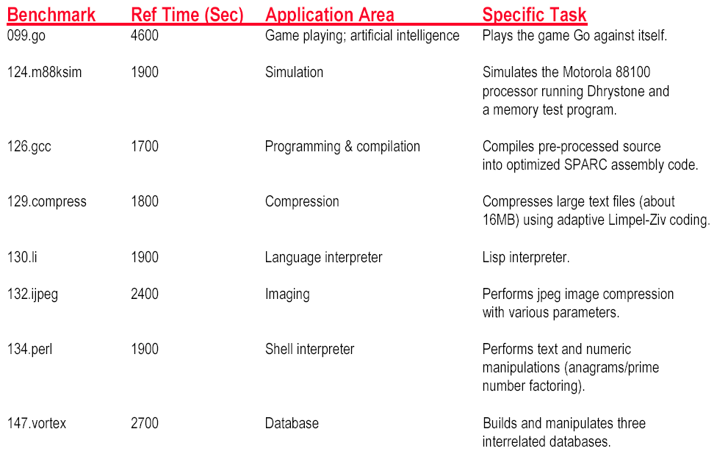
SPEC INT 95 Benchmark descriptions

Slide 82
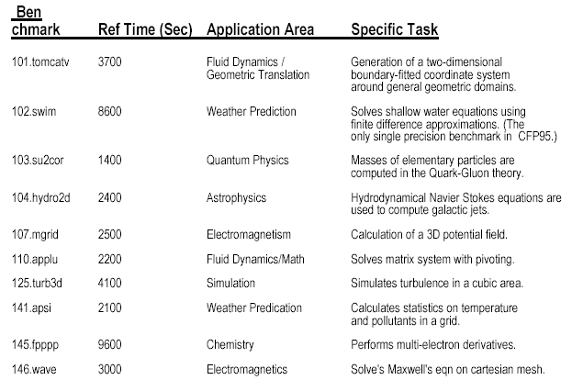
SPEC FP 95 Benchmark Descriptions

Slide 83
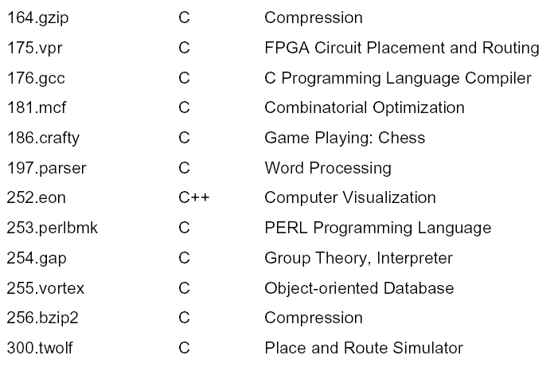
New SPEC Int 2000 Benchmarks

Slide 84
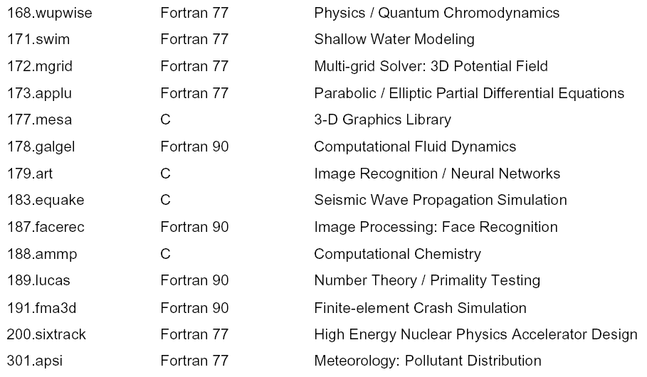
New SPEC FP 2000 Benchmarks

Slide 85
SPEC benchmarks Server Benchmarks
SPECrate--processing rate of a multiprocessor
SPEC CPU2000—throughput-oriented benchmark
SPECrate—processing rate of a multiprocessor
SPECSFS--file server benchmark
SPECWeb--Web server benchmark
Transaction-processing (TP) benchmarks
TPC benchmark—Transaction Processing Council
TPC-A, 1985
TPC-C, 1992,
TPC-H→ TPC-R→TPC-W

Slide 86
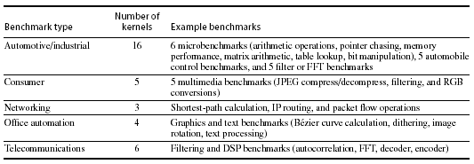
SPEC benchmarks Embedded Benchmarks
EDN Embedded Microprocessor Benchmark Consortium (or EEMBC, pronounced “embassy”).

Slide 87
Running Benchmarks
Key factor: Reproducibility by other experimenters.
Details, details, and more details !!! List all assumptions and conditions of your experiments.
i.e. program input, version of the program, version of the compiler, optimization level, OS version, main memory size, disk types, etc.
A system’s software configuration can significantly affect the performance results for a benchmark.

Slide 88
Comparing Two Machines
Machine CPI Clock Period Avg Instruction Time (secs)
Machine A 1.2 2 ns
Machine B 2.5 1 ns
CPU Time = # of instructions executed * avg instruction time
Assume 1,000,000, 000 instructions
Machine A: 1,000,000,000 * 2.4ns = 2.4 seconds
Machine B: 1,000,000,000 * 2.5ns = 2.5 seconds
Which machine is faster? Machine A
How much faster? 2.5 / 2.4 = 1.04 times faster

Slide 89
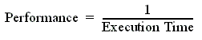
Comparing Performance
Often, we want to compare the performance of different machines or different programs. Why?
To help engineers understand which is “better”
To give marketing a “silver bullet” for the press release
To help customers understand why they should buy <my machine>
Performance and Execution time are reciprocals
Maximizing performance means minimizing response (execution) time

Slide 90
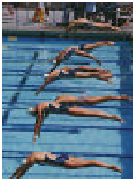
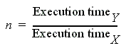
Common used phrases
“Performance of P₁ is better than P₂ ” is, for a given work load L, P₁ takes less time to execute L than P₂ does
performance(P1) > Performance(P2)
⇒ Execution Time(P1, L) < Execution Time(P1, L)
“Processor X is n times fast than Y” is

Slide 91
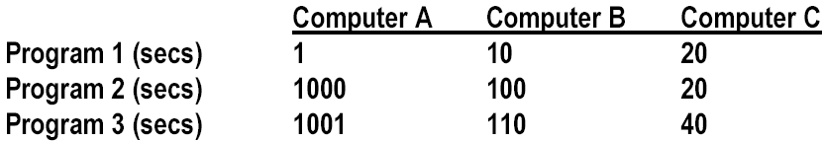
Comparing Performance Across Multiple Programs
A is 10 times faster than B for program 1
B is 10 times faster than A for program 2
A is 20 times faster than C for program 1
C is 50 times faster than A for program 2
B is 2 times faster than C for program 1
C is 5 times faster than B for program 2
Each statement above is correct…,
…but we want to know which machine is the best?

Slide 92
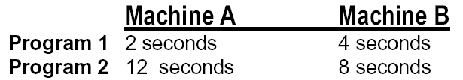
Let’s Try a Simpler Example
Two machines timed on two benchmarks
How much faster is Machine A than Machine B?
Attempt 1: ratio of run times, normalized to Machine A times
program1: 4/2 program2 : 8/12
Machine A ran 2 times faster on program 1, 2/3 times faster on program 2
On average, Machine A is (2 + 2/3) /2 = 4/3 times faster than Machine B
It turns this “averaging” stuff can fool us

Slide 93
Example: Second answer
Two machines timed on two benchmarks
How much faster is Machine A than Machine B?
Attempt 2: ratio of run times, normalized to Machine B times
program 1: 2/4 program 2 : 12/8
Machine A ran program 1 in 1/2 the time and program 2 in 3/2 the time
On average, (1/2 + 3/2) / 2 = 1
Put another way, Machine A is 1.0 times faster than Machine B

Slide 94
Example: Third answer
Two machines timed on two benchmarks
How much faster is Machine A than Machine B?
Attempt 3: ratio of run times, aggregate (total sum) times,
Machine A took 14 seconds for both programs
Machine B took 12 seconds for both programs
Therefore, Machine A takes 14/12 of the time of Machine B
Put another way, Machine A is 6/7 faster than Machine B

Slide 95
Which is Right?
Question:
How can we get three different answers?
Solution
Because, while they are all reasonable calculations…
…each answers a different question
We need to be more precise in understanding and posing these performance & metric questions

Slide 96
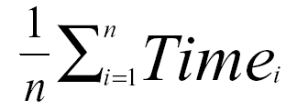
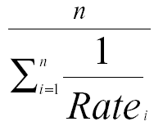
Arithmetic and Harmonic Mean
Total Execution Time: A Consistent Summary Measure
Arithmetic mean is the average of the execution time that tracks total execution time.
If performance is expressed as a rate, then the average that tracks total execution time is the harmonic mean

Slide 97
Problems with Arithmetic Mean
Applications do not have the same probability of being run
Longer programs weigh more heavily in the average
For example, two machines timed on two benchmarks
Machine A Machine B
Program 1 2 seconds (20%) 4 seconds (20%)
Program 2 12 seconds (80%) 8 seconds (80%)
If we do arithmetic mean, Program 2 “counts more” than Program 1
an improvement in Program 2 changes the average more than a proportional improvement in Program 1
But perhaps Program 1 is 4 times more likely to run than Program 1

Slide 98
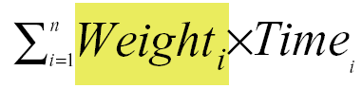
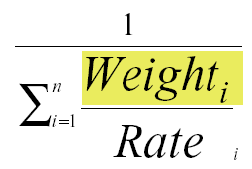
Weighted Execution Time
Often, one runs some programs more often than others. Therefore, we should weight the more frequently used programs’ execution time
Weighted Harmonic Mean

Slide 99
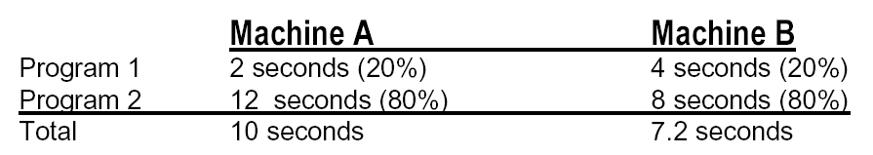
Using a Weighted Sum or weighted average
Allows us to determine relative performance 10/7.2 = 1.38
--> Machine B is 1.38 times faster than Machine A

Slide 100

Another Solution
Normalize run time of each program to a reference
So when we normalize A to B, and average, it looks like A & B are the same.
But when we normalize B to A, it looks like B is 33% better!

Slide 101


Example
33744 1
W(B)₁= ⎯⎯⎯⎯⎯⎯⎯⎯⎯ = 0.909
10×(1/10＋1/100)
1
W(B)2= ⎯⎯⎯⎯⎯⎯⎯⎯⎯ = 0.091
100×(1/10＋1/100)
Equal-time weighting

Slide 102

Geometric Mean
Used for relative rate or performance numbers
Geometric mean’s nice property
Geometric mean(Xi) Xi
Geometric mean(Yi) Yi
=Geometric mean( )

Slide 103

Using Geometric Mean
Drawback:
Geometric mean does NOT predict run time
Normalizes.
Each application now counts equally.
Advantage: Irrelevance of the reference computer in relative performance

Slide 104
Summary of comparing performance
Total execution time or arithmetic mean
consistent result
programs in the workload are NOT always run an equal number of times
Weighted arithmetic mean
take into account the frequency of use in the workload
solution depends on which machine is the reference.
Normalized Geometric Mean---SPEC Ratio
consistent result, no matter which machine is the reference.
Geometric mean does NOT predict run time
Ideal solution : Measure a real workload and weight the programs according to their frequency of execution.
What really matters is how YOUR application performs

Slide 105

New SPEC Performance Numbers
Geometric Mean of 12 (SpecInt) and 14 (SpecFP) Benchmarks
Performance measured against SPARC 10/40
2000 Performance Numbers (Microprocessor Report, Dec. 2000)

Slide 106

New SPEC Performance Numbers
Geometric Mean of 12 (SpecInt) and 14 (SpecFP) Benchmarks
Performance measured against SPARC 10/40
2001 Performance Numbers (Microprocessor Report, Aug. 2001)

Slide 107
Topics in Chapter
1.1 Why take this course ?
1.2 Classes of computers in current computer market
1.3 Defining computer architecture and What’s the task of computer design?
1.4 Trends in Technology
1.5 Trends in power in Integrated circuits
1.6 Trends in Cost
1.7 Dependability
1.8 Measuring, Reporting and summerizing Perf.
1.9 Quantitative Principles of computer Design
1.10 Putting it altogether

Slide 108
1.9 Quantitative Principles
Take advantage of parallelism
Principle of Locality
Focus on the common case
Amdahl's Law
CPU Performance Equation

Slide 109
Take advantage of parallelism
Most important methods of improving performance
Parallelism levels
System level: use multiple processors
Instruction level:
Pipelining
Operation level:
set-associate cache
Pipelined function unit
Any other examples ?

Slide 110
Principle of Locality
Any example ?
Program Property: Programs tend to reuse data and instructions they have used recently.
Rule of thumb:
a program spends 90% of its execution time in only 10% of the code.
Temporal locality
Recently accessed items are likely to be accessed in the near future.
Spatial locality
Items whose addresses are near one another tend to be referenced close together in time.

Slide 111
Focus on the common case
The most important and pervasive principle of computer design.
Power, resource allocation, performance, dependability.
Rule of thumb: simple is fast.
Frequent case is often simpler and can be done faster.
A fundamental law, called Amdahl’s Law, can be used to quantify this principle.

Slide 112

Amdahl’s Law
The performance improvement to be gained from using some faster mode of execution is limited by the fraction of the time the faster mode can be used.
Example

Slide 113
Amdahl’s law
Increasing the clock rate would not affect memory access time
Using a floating point processing unit does not speed integer ALU operations

Slide 114
Amdahl’s law
Amdahl's law defines the speedup
If we know two factors:
Fraction enhanced : Fraction of computation time in original machine that can be converted to take advantage of the enhancement.
Speedup enhanced in enhanced mode : Improvement gained by enhanced execution mode:

Slide 115

Speedup Equation
Example:
A server system with an enhanced CPU( 10 times faster than the original one) used for Web serving. Assuming the original CPU is busy with computation 40% of the time and is waiting for I/O 60% of the time.
Answer:
Fraction_{enhanced} = 0.4, Speedup_{enhanced} =10
Speedup = 1 = 1 = 1.56
0.6 + 0.4 0.64
10

Slide 116
Another Example
Implementations of floating-point (FP) square root vary significantly in performance
Two enhancement proposal
One proposal is to enhance the FPSQR hardware and speed up this operation by a factor of 10.
The alternative is just to try to make all FP instructions in the graphics processor run faster by a factor of 1.6;
Assuming
FP square root (FPSQR) is responsible for 20% of the execution time of a critical graphics benchmark.
FP instructions are responsible for a total of 50% of the execution time for the application.
The design team believes that they do both enhancement with the same effort.
Compare these two design alternatives.

Slide 117

Solution of the example

Slide 118
Example for dependability-1
Given:
Failure rate_{system} = 10*1/1000,000 + 1/500,000 + 1/200,000 + 1/100,000
10 + 2 + 5 + 5 + 1
=-----------------------------
1,000,000
= 23000/1000,000,000
So, Power failure% = 5/23 = 0.22

Slide 119
Example for dependability-2
Reliability of the power supply can be improved via redundancy:
200000 → 830,000,000 ~ 4150X 5/23
Reliability improvement
1
= ----------------------------- = 1.28
(1-0.22) + 0.22/4150

Slide 120
What the Amdahl’s Law imply ?
If an enhancement is only usable for a fraction of task, then the total speedup will be no more than 1/ (1-F).
Serve the guide
to how much an enhancement will improve performance
to how to distribute resource to improve cost-performance
Useful for comparing
the overall system performance of two alternatives,
two CPU design alternatives
We can improve the performance by
increasing the Fraction_{enhanced}
or, increasing the Speedup_{enhanced}

Slide 121

The CPU Performance Equation
The “Iron Law” of processor performance:
Often it is difficult to measure the improvement in time using a new enhancement directly.
CPU Performance Equation

Slide 122
Calculation of CPU Time
CPU time = Instruction count × CPI × Clock cycle time
Or
Architecture --> Implementation --> Realization
Compiler Designer Processor Designer Chip Designer

Slide 123
Related technologies
CPU performance is dependent upon 3 characteristics:
clock cycle (or rate) ( CCT )
clock cycles per instruction ( CPI )
instruction count. ( IC )
One difficulty: It is difficult to change one in isolation of the others.
Inst Count CPI Clock Rate
Program X
Compiler X (X)
Inst. Set. X X
Organization X X
Technology X

Slide 124



Other format of CPU Performance Equation

Slide 125
Example of CPUtime calculation
Suppose we have made the following measurements:
Frequency of FP operations (other than FPSQR) = 25%
Average CPI of FP operations = 4.0
Average CPI of other instructions = 1.33
Frequency of FPSQR = 2%
CPI of FPSQR = 20
Two design alternatives
decrease the CPI of FPSQR to 2
decrease the average CPI of all FP operations to 2.5.
Compare these two design alternatives using the CPU performance equation.

Slide 126


Answer to the question
Since the CPI of the overall FP enhancement is slightly lower, its performance will be marginally better.

Slide 127

Compare the result with that from Amdahl’s law
This is the same speedup we obtained using Amdahl’s Law:

Slide 128
Suppose that there are four types of operations in an application. After making enhancements to the original function units, each type of operation gains performance improvement as shown in the following table.
1) What’s the enhanced speedup of each operation respectively after improving?
2) What’s the overall speedup of the application respectively after only improving Op2 or Op4?
Hint: Calculate the overall speedup considering only one of the enhanced function units is used. There are 2 situations.
Operation Type | IC (total 100) | CPI before enhancement | CPI after enhancement
Op1 | 10 | 2 | 1
Op2 | 30 | 20 | 15
Op3 | 35 | 10 | 3
Op4 | 25 | 4 | 1

Slide 129
Performance & price-performance
Factors that responsible for the wide variation in price
Different levels of expandability
Use of cheaper disks and cheaper memory
Cost of CPU varies
Software differences
Lower-end system use PC commodity parts in fans, power supply, support chip sets
Commoditization effect

Slide 130
Five desktop and rack-mountable systems
1GB ECC SDRAM, 80GB disk
Expandability(可扩展性):
Sun Java worktation < Dell < HP BL25p
Cost of processor: die size, L2 cache, clock rate, cache size
Softerware difference

Slide 131

Price-performance www.spec.org

Slide 132
Messurements-1
For Servers
TPC-C : standard industry benchmark for OLTP
Reasonable approximation
Measure total system performance
Rules of measurement are very complete
Vendors devote significant effort
Report both performance & price-performance

Slide 133

Price-performance TPC-C 2005.7

Slide 134
TPC-C & TPC-E
TPC(TransactionProcessing PerformanceCouncil)
10 members http://www.tpc.org
TPC-C:
benchmark for OnLine Transaction Processing
simulates a complete environment where a population of terminal operators executes transactions against a database
TPC-E
simulates the OLTP workload of a brokerage firm
TPC-C&TPC-E
http://www.searchsv.com.cn/showcontent_13524.htm

Slide 135
tpsE & tpsE/&100000

Slide 136

Power performance for 3 servers
Best power perf

Slide 137
Fallacies & pitfalls
Pitfall(易犯的错误):
Falling prey to Amdahl’s Law.
Not to try to improve some unit of small F
A single point of failure
An example of dependability
Don’t forget the single fan !

Slide 138
Fallacy1 : the cost of the processor dominates the cost of the system.

Slide 139
Fallacy
Benchmarks remain valid indefinitely
“Benchmarksmanship” “benchmark engineering”
The rated mean time to failure of the disks is 1200000 hours or almost 140 years, so disks practically never fail.
Real-world MTTF is about 2-4 times worse than manufacturer’s MTTF for ATA disks, 4-8 times worse for SCSI disks
( ATA: AT Attachment )
SCSI: Small Computer System Interface )
Peak performance tracks observed performance.

